Slide 1
Front End Engineering-I Project
Team Details:
AMANJOT SINGH (2310990106)
AMJAD MISHAL V.P (2310990107)
ANANYA (2310990108)
Faculty Coordinator: DR. AMANDEEP KAUR
:
Chitkara University Institute of Engineering and Technology,
Chitkara University, Punjab

Slide 2
Table of Contents
Introduction
Problem Statement
Technical Details
Key Features
Project Highlights
Bonus Feature(optional)
Conclusion
References/Links used

Slide 3




Introduction
SOCIAL SHARE BUTTON
Social media seem to have become an indispensable part of our daily lives. Started for the purpose of just connecting people with their close ones, it has developed itself to an enormous online global market.
The business which operates and depends on the online venture to market their products and services find social media to be one of a central resource for their revenues.
The past few years proved to be evolutionary as content and information sharing have taken a step further and has become more dynamic and reachable to a vast audience more quickly.

Slide 4

Problem Statement
When a user clicks on a social share button, it triggers a share intent, prompting them to log in (if not already logged in) and compose a message or select an audience. The user can then post the content to their social media account.

Slide 5

Technical Details
HTML and CSS: The foundation of social share buttons is HTML and CSS, which define the structure and style of the buttons on your webpage. You can create simple button elements and style them to match your site's design.
2.JavaScript: JavaScript is used to add interactivity to the share buttons. You can use it to handle button clicks and open share dialogs when a user clicks on a social share button.
3.Responsive Design: Ensure that your share buttons are responsive so that they look good and function well on various devices and screen sizes.
4.Custom Icons: You can create custom icons or use pre-designed social media icons to represent each platform in your share buttons.

Slide 6

Key Features
Here are some key aspects and considerations related to social share buttons:
1. Placement: Social share buttons are usually placed strategically on a webpage or app screen, often near the content being shared. Common
locations include at the top or bottom of articles, on the side of images or videos, or in floating bars that follow the user as they scroll.
2. Icons and Labels: Each button typically features the logo or icon of the respective social media platform, making it easily
recognizable to users. Some buttons may also include a label (e.g., "Share on Facebook" or "Tweet this") to clarify the action.
3. Mobile Friendly Design: Ensure that share buttons are responsive and look good on mobile devices. Mobile users
make up a significant portion of web traffic . Use appropriately sized icons and spacing for touch interaction.

Slide 7
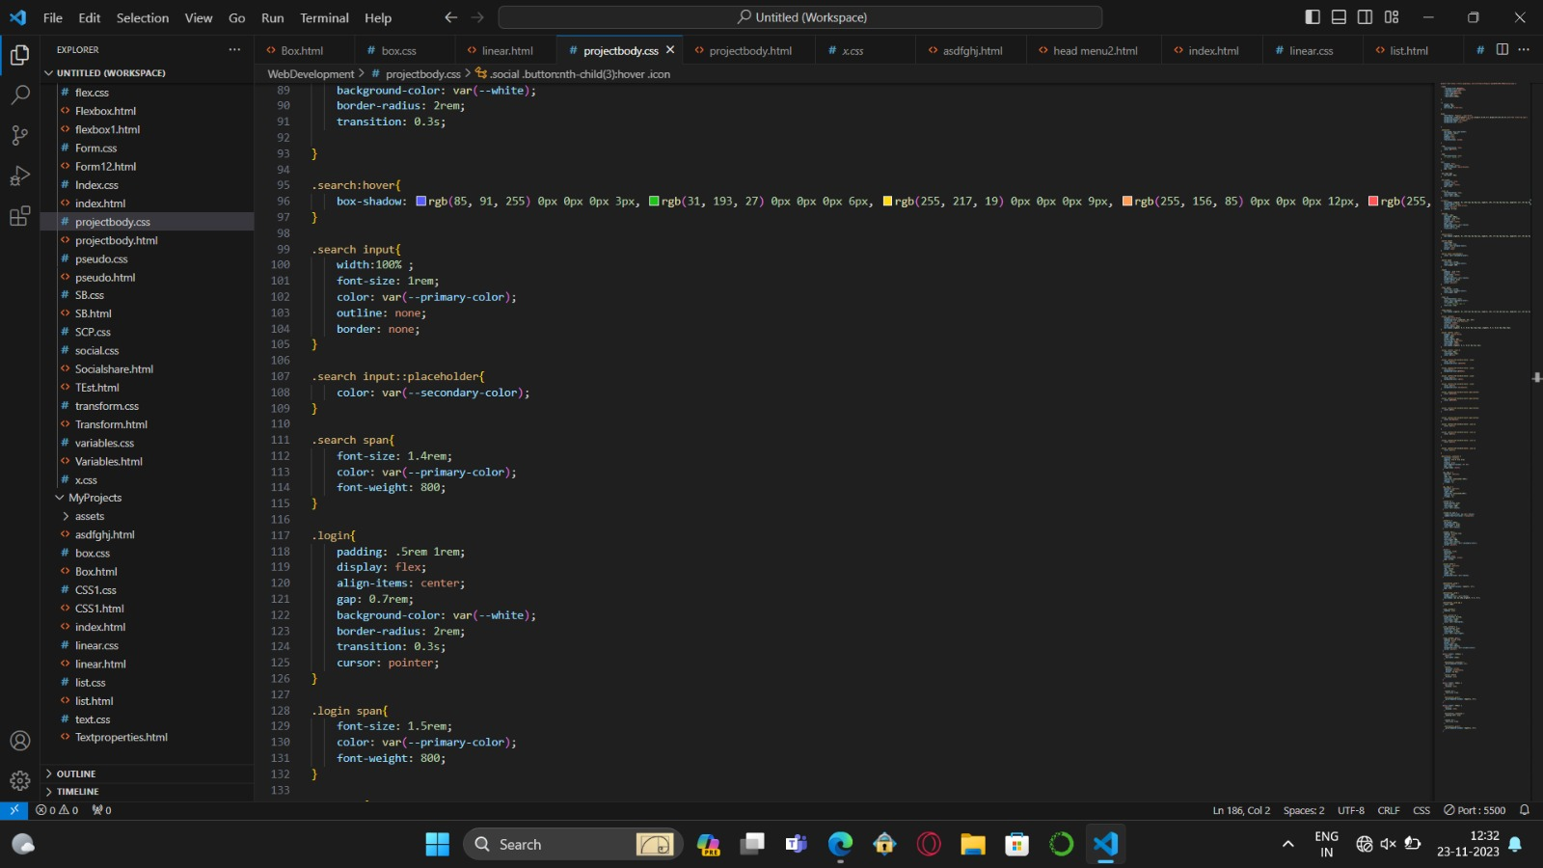
Project Highlights

Slide 8
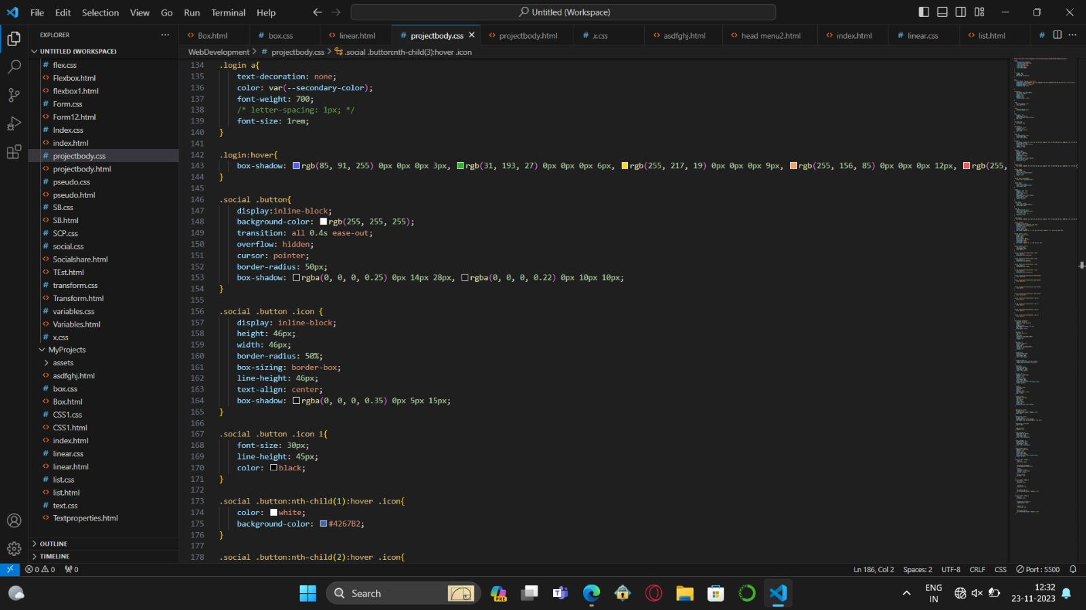

Slide 9
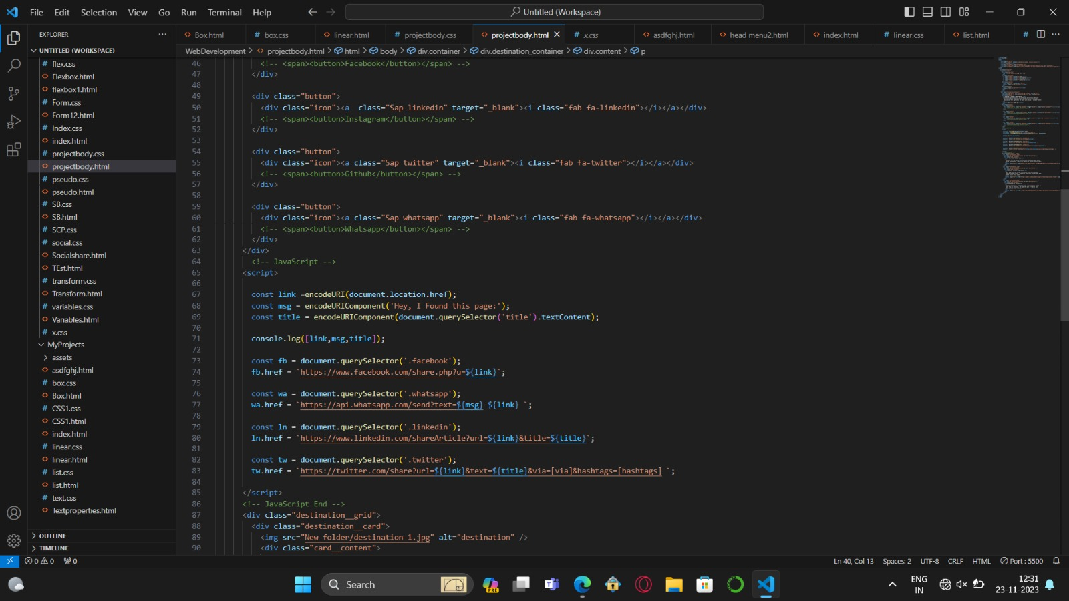

Slide 10
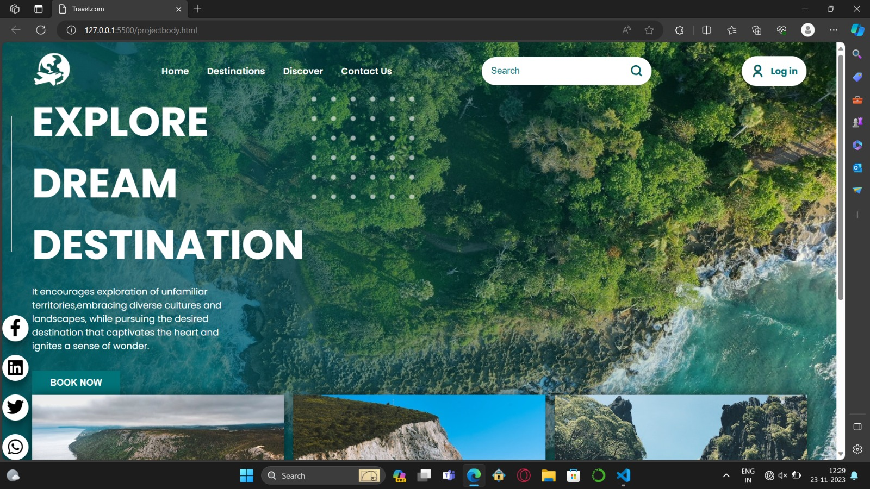
WORKING

Slide 11

Conclusion
Social sharing buttons are the interstates of web content. With a single click, visitors can endorse or share an article with their entire social network, so your content can travel quickly and efficiently across the vast expanse of the internet, reaching new audiences . So, if part of your business model involves creating content to promote your products or services, you’d naturally want the maximum number of (qualified) people to see that content . If your goal is to create useful, entertaining and educational blog posts that offer something new to consumers, and you’re not just churning out bad copy for the sake of driving traffic, then it makes sense that readers would want to share that content. So why not make it easy on them?

Slide 12
References/Links used
During the research of social share buttons we were able to find a major problem that was lack of knowledge . So various references ,help and websites were used by us including:
https://www.mightybytes.com/blog/social-buttons-pros-and-cons/
ChatGPT
Wikipedia

Slide 13


